Slide 1
Poker Hands Classification
Somil Shah
Sneha Shahane
Aayushi Sikligar

Slide 2
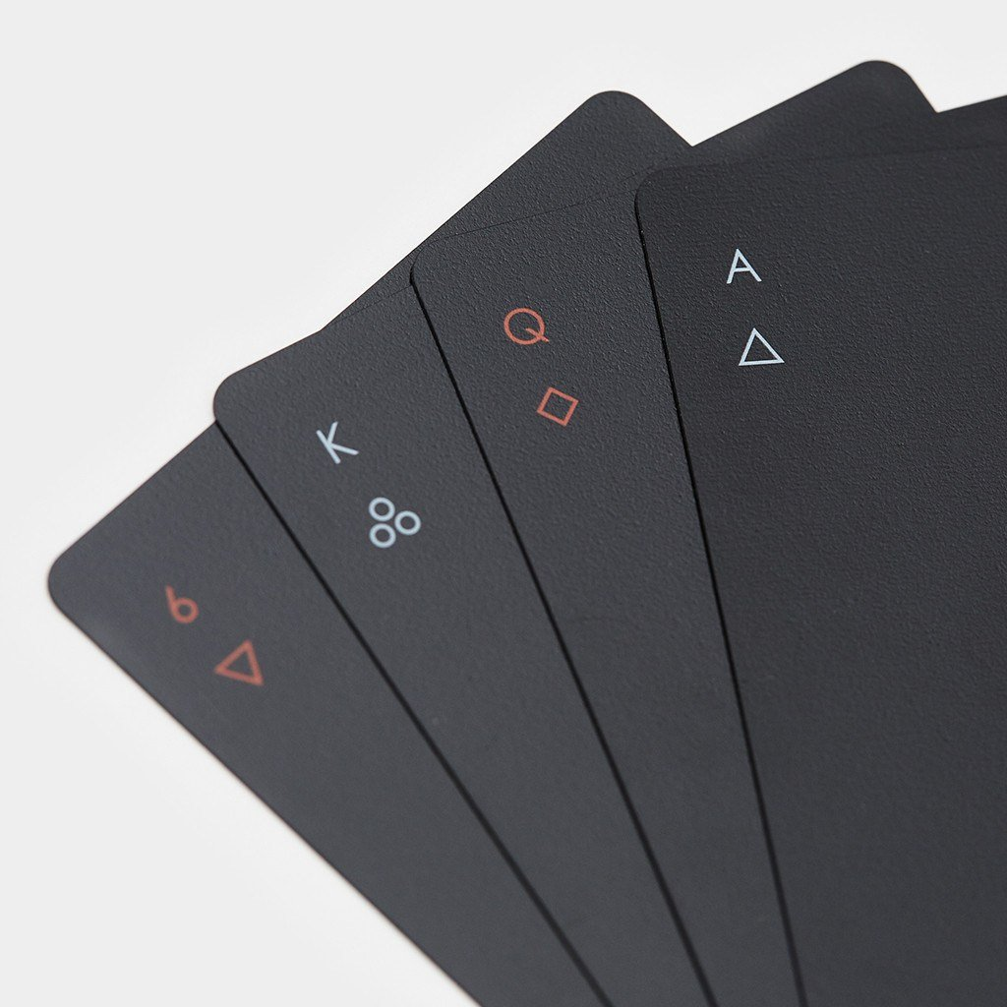
Problem Statement
Five playing cards drawn from a standard deck of 52.
Given those 5 cards predict the most likely possible hand from those 5 cards.
The order of cards is important.
Notes:
Given 5 cards drawn from a deck of 52 cards, predict which is the most likely hand from the cards.
The order and suit of the cards is very important for predictions.

Slide 3
Why?
Difficult classification task.
Helps in getting valuable insights on various algorithms.
1 Million test samples compared to 25000 training samples.
Notes:
We can have around 2.5 million combinations of Poker Hands, hence classifying accurately is a difficult task. Hence, it helps to get insights on various machine learning algorithms.

Slide 4


Dataset Description
1) S1, S2, S3, S4, S5 ( Suit of card #n ):
{Hearts, Spades, Diamonds, Clubs}
2) C1, C2, C3, C4, C5(Rank of card #n):
{Ace, 2, 3, ... , Queen, King}
3) Output Class(Poker Hand)
Notes:
The dataset contains the suit and rank of 5 cards drawn randomly from a deck of 52.
Suit means whether the card is a heart/spade/diamond/club. The categorical data is encoded into numeric values ranging from 1-4.
Similary rank means if the card Ace, 2, 3, … King, Queen.

Slide 5
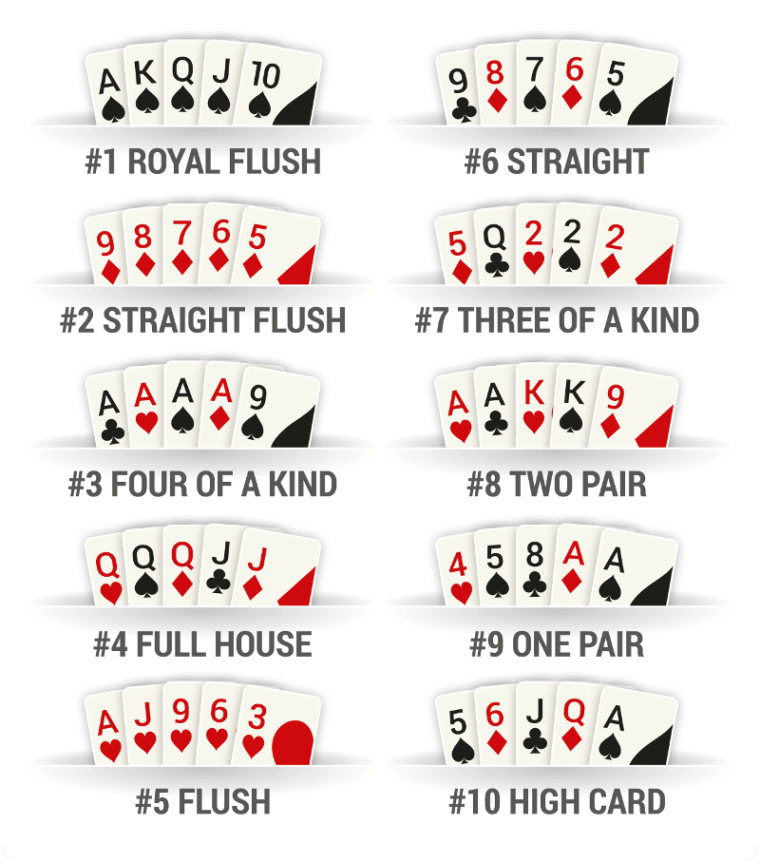
For those who might not know how it works(and it’s not as easy as it sounds, at least not for your computer.)
Notes:
To give you an overview on Poker, this is how it works.

Slide 6
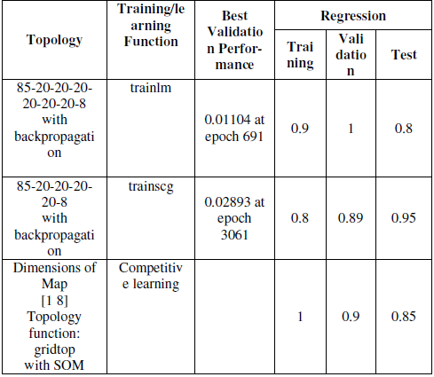
Literature Survey
The paper “POKER HAND CLASSIFICATION” uses ANNs and SOM to predict Poker Hands.
It reaches to 80% accuracy during training and 94% accuracy during testing,
Our model gives out 92% training accuracy and 94.5% accuracy during testing.

Slide 7
Algorithms used
Being a classification Problem, these are the classification algorithms used
Decision Tree
Random Forest
Naive Bayes
AdaBoost
ANN(Artificial Neural Networks)
Notes:
We have used a handful of ML algorithms like... to achieve maximum accuracy.

Slide 8
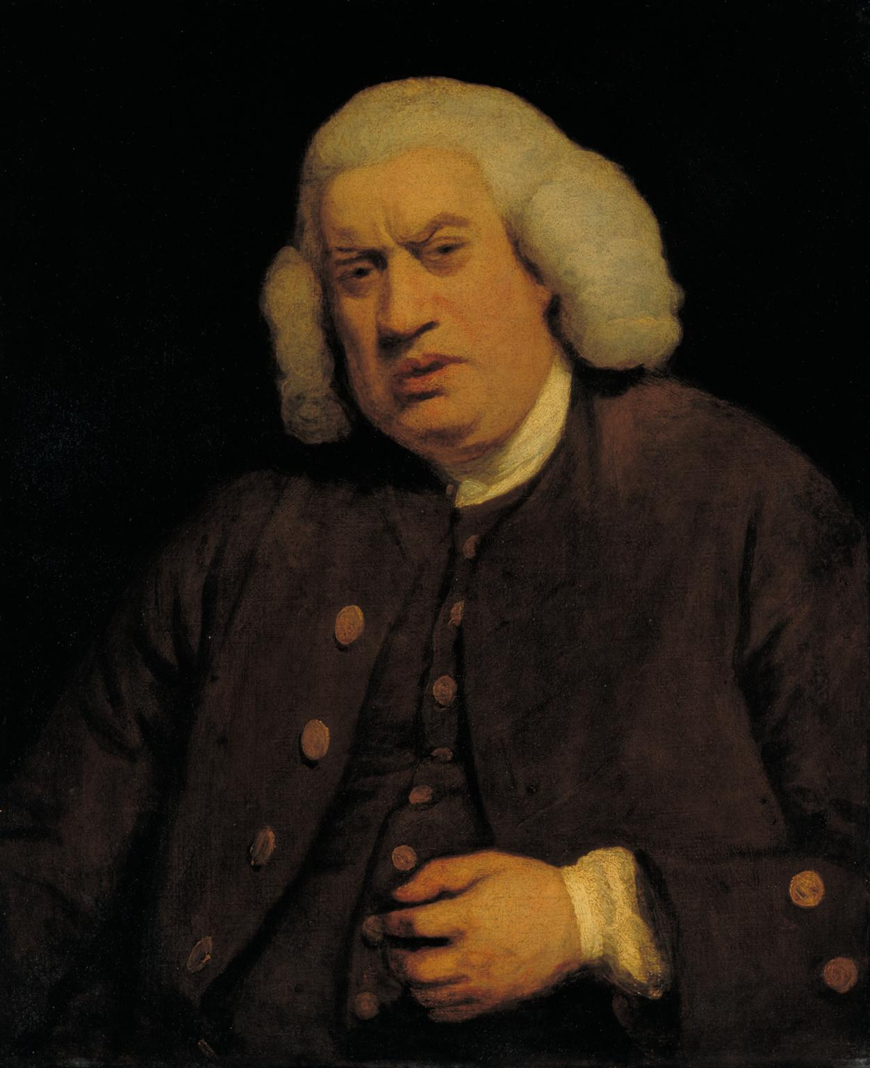
Before we jump on to the main part, we need to take care of something.
????

Slide 9
Data Preprocessing
Cleaning the data
Finding missing values and removing or filling them.
Scaling the data
Removing unnecessary attributes
Encoding the values
Categorical Encoding
Label Encoding
Dividing into training and test set
Why?
Notes:
We have preprocessed data for better performance and accuracy.
We have used some of the preprocessing methods like data cleaning, one hot encoding etc.
Let’s go into detail for each of them.

Slide 10
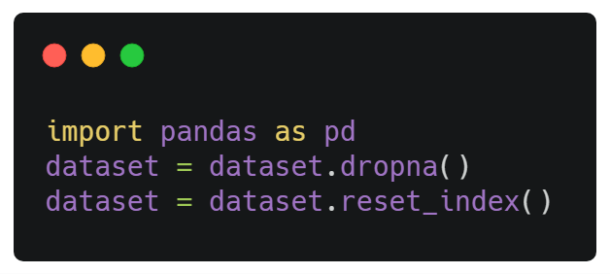
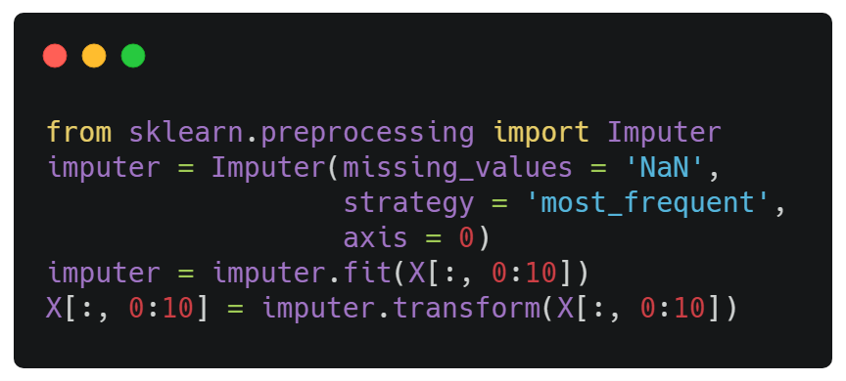
Removing rows which have missing classes.
Filling values with most frequent values column-wise.
Cleaning the data
X1 | X2 | Y
2 | 5 | 2
3 | 6 | Nan
X1 | X2 | Y
2 | Nan | 2
3 | 6 | 1

Slide 11
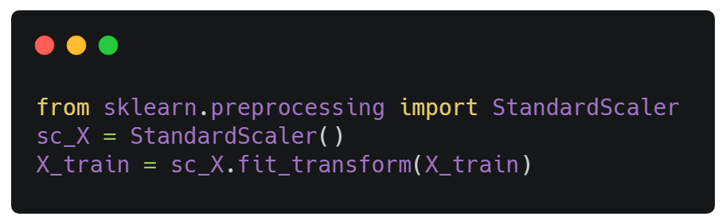
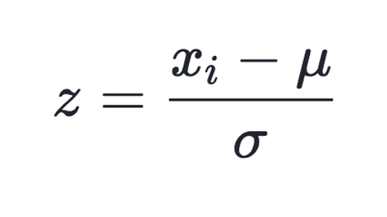
Normalizing the features
Scaling the data
Notes:
Why do we scale data?
Different attributes might contain values ranging between different magnitudes,
To normalize the data so that the mean is 0 and sd is 1.
Range between -1 to 1
Also, helps in faster computations.
Might not help much in algorithms like Naive Bayes, but might help a lot in Deep Learning algorithms

Slide 12
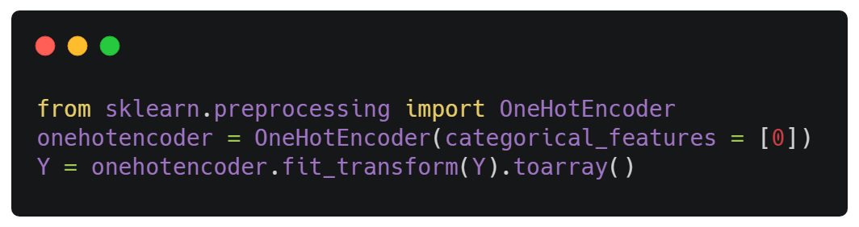
Here, we one hot encode the output classes
Encoding the values (ANNs)
Now, we are officially done! Let’s move to the core part..
Notes:
One hot encoding converts the output classes into binary formats.
This is important for ANNs since there are seperate nodes for each classes.

Slide 13
Random Forest Classifier
One of the most powerful and popular tool for classification and regression tasks.
Builds multiple Decision trees and merges them together which proves for better performance.
Advantage over Decision Trees- Prevents overfitting
Notes:
It’s quite a powerful tool for classification and regression tasks.
In its simplest terms it builds multiple decision trees and merges them.
This helps in overfitting which is a disadvantage in Decision Trees

Slide 14
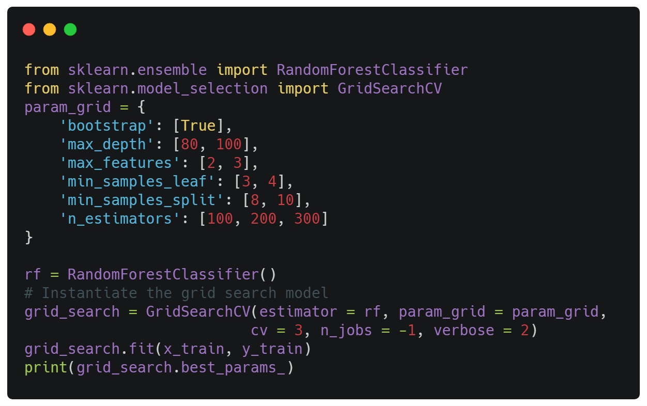
Hyper Parameter Tuning/K Fold Cross val
GridSearchCV
Notes:
Grid Search CV
Its an hybrid of Grid Search and K Fold Cross Validation.
In Grid Search, we pass all the parameter values we wish for our model to train.
It uses all possible combinations of parameter values, trains the model on each of them and gives out the best parameters.
Cross Validation
Suppose we want to perform 5-fold cross validation.
The data is divided into 5 sets, 4 are given for training and 1 is tested.
The algorithm is trained and tested K times for such K combinations.

Slide 15
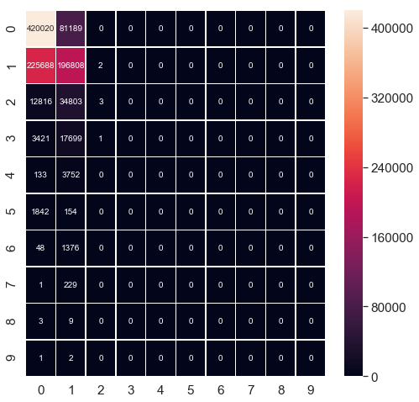
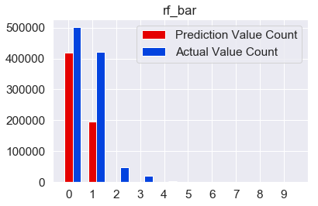
Results: 61% Accuracy

Slide 16
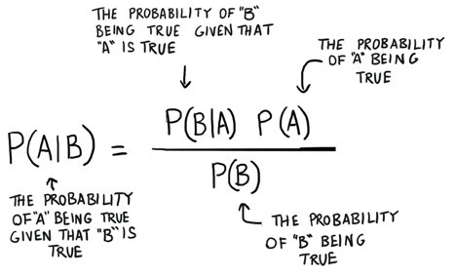
Naive Bayes
Calculates the probabilities for every factor.
Then it selects the outcome with highest probability.
Notes:
Naive Bayes, based on Bayes’ Theorem,
calculates probabilities for every factor
and then selects the outcome with the highest probability

Slide 17
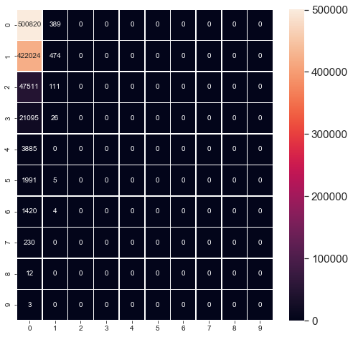
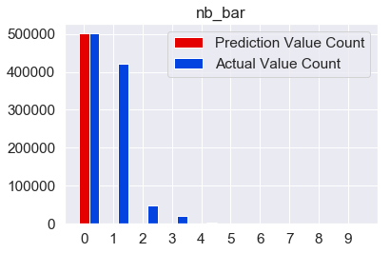
Results: 50% Accuracy

Slide 18
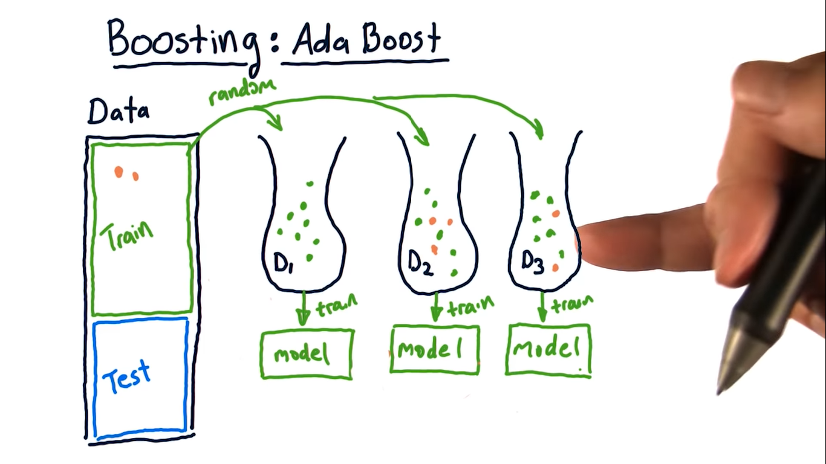
AdaBoost
Takes a weak learner( any algorithm that performs poorly) and converts it into a strong learner.
Uses bagging with boosting to improve performance.
Notes:
https://hackernoon.com/boosting-algorithms-adaboost-gradient-boosting-and-xgboost-f74991cad38c

Slide 19
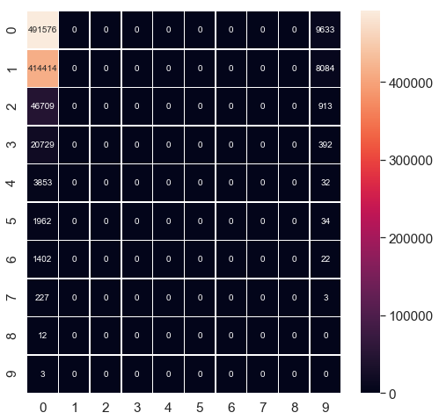
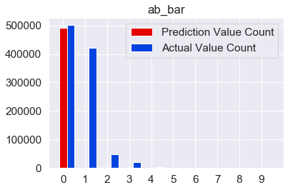
Results: 60% Accuracy

Slide 20
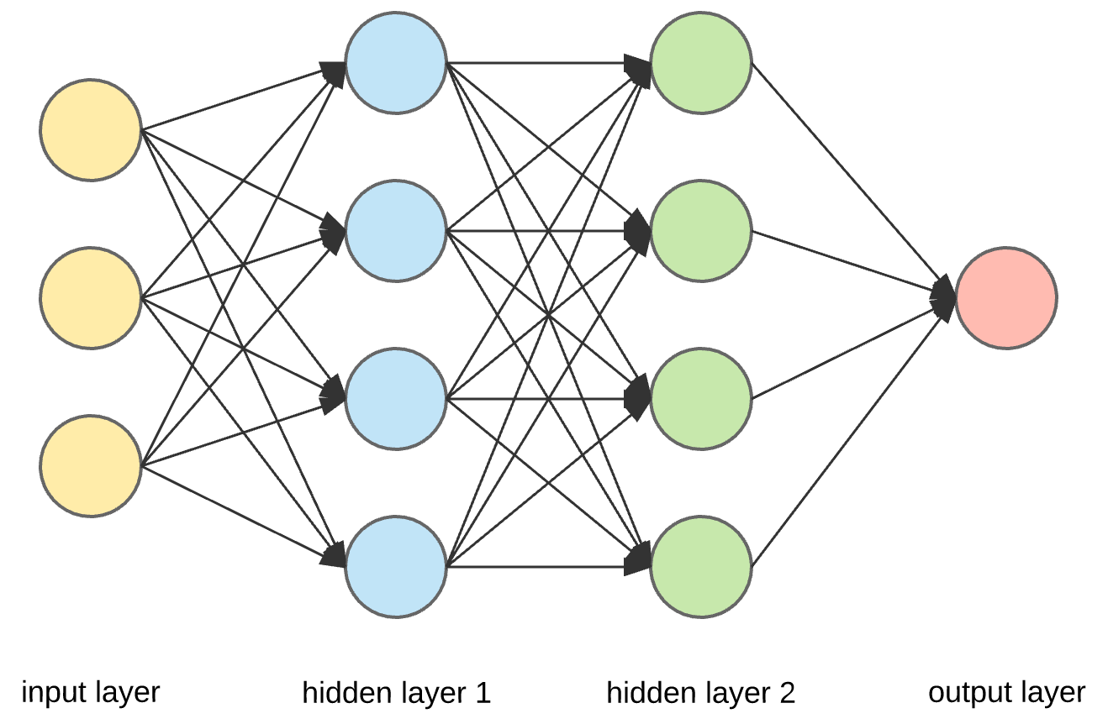
ANNs
Feed Forward Neural Network.
Uses Gradient Descent to learn the weight values.
Highly powerful but also highly unpredictive.

Slide 21
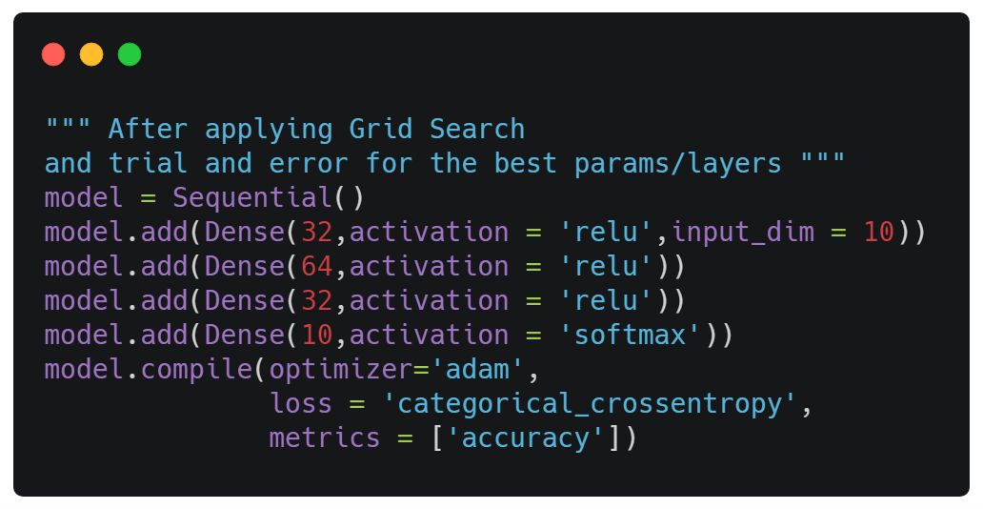
Model Architecture

Slide 22
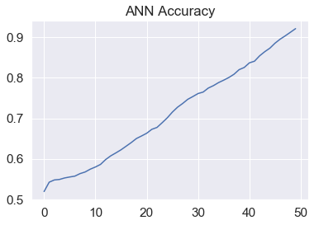
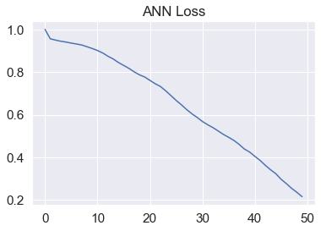
Results: 94.5% Accuracy

Slide 23
Results
SNo. | Accuracy | Model Name
0 | 48.00% | Decision Tree
1 | 60.16% | AdaBoost
4 | 50.13% | Naive Bayes
3 | 61% | Random Forest
2 | 94.50% | ANN

Slide 24

Conclusion:
ANNs work best giving the accuracy of 94.5% overall.

